Slide 1
Diversity Task Force
Meeting Notes June 17, 2020

Slide 2
Our mission: We bring business to La Jolla Village
Augment with a Statement of Diversity
Diversity is core value of the La Jolla Village Merchants Association.
Create a Diversity Statement (LJVMA’s Commitment to Diversity)
Everything we do is filtered through our commitment to diversity. All initiatives must meet the following diversity and inclusion standards.
Diversity is core value. We are better through equality, equity and open mindedness.
LJVMA values diversity of all types. We take pride in welcoming all people, all groups, all walks of life to live, work, play, shop, dine and learn in La Jolla Village.
Together we strive to engage, hire and attract people of all races, religions, age, gender, national origin, identity, experience and profession.
We continually strive to create and nurture a community culture in which inclusiveness is a reflex, not an initiative.
We know through experience that different ideas, perspectives, and backgrounds promote a stronger and more creative work environment that delivers better results.

Slide 3
4 Pillars (Main Street America)
Specific action steps under each of our 4 Pillars.
Submit to Board in July
Bring to Marketing Committee Next Week
Use Draft Ideas (previously submitted and prioritize)
Four Pillars
Organizational Excellence
Promotions and media
Merchant Education/Resources + Economic Development
Design

Slide 4
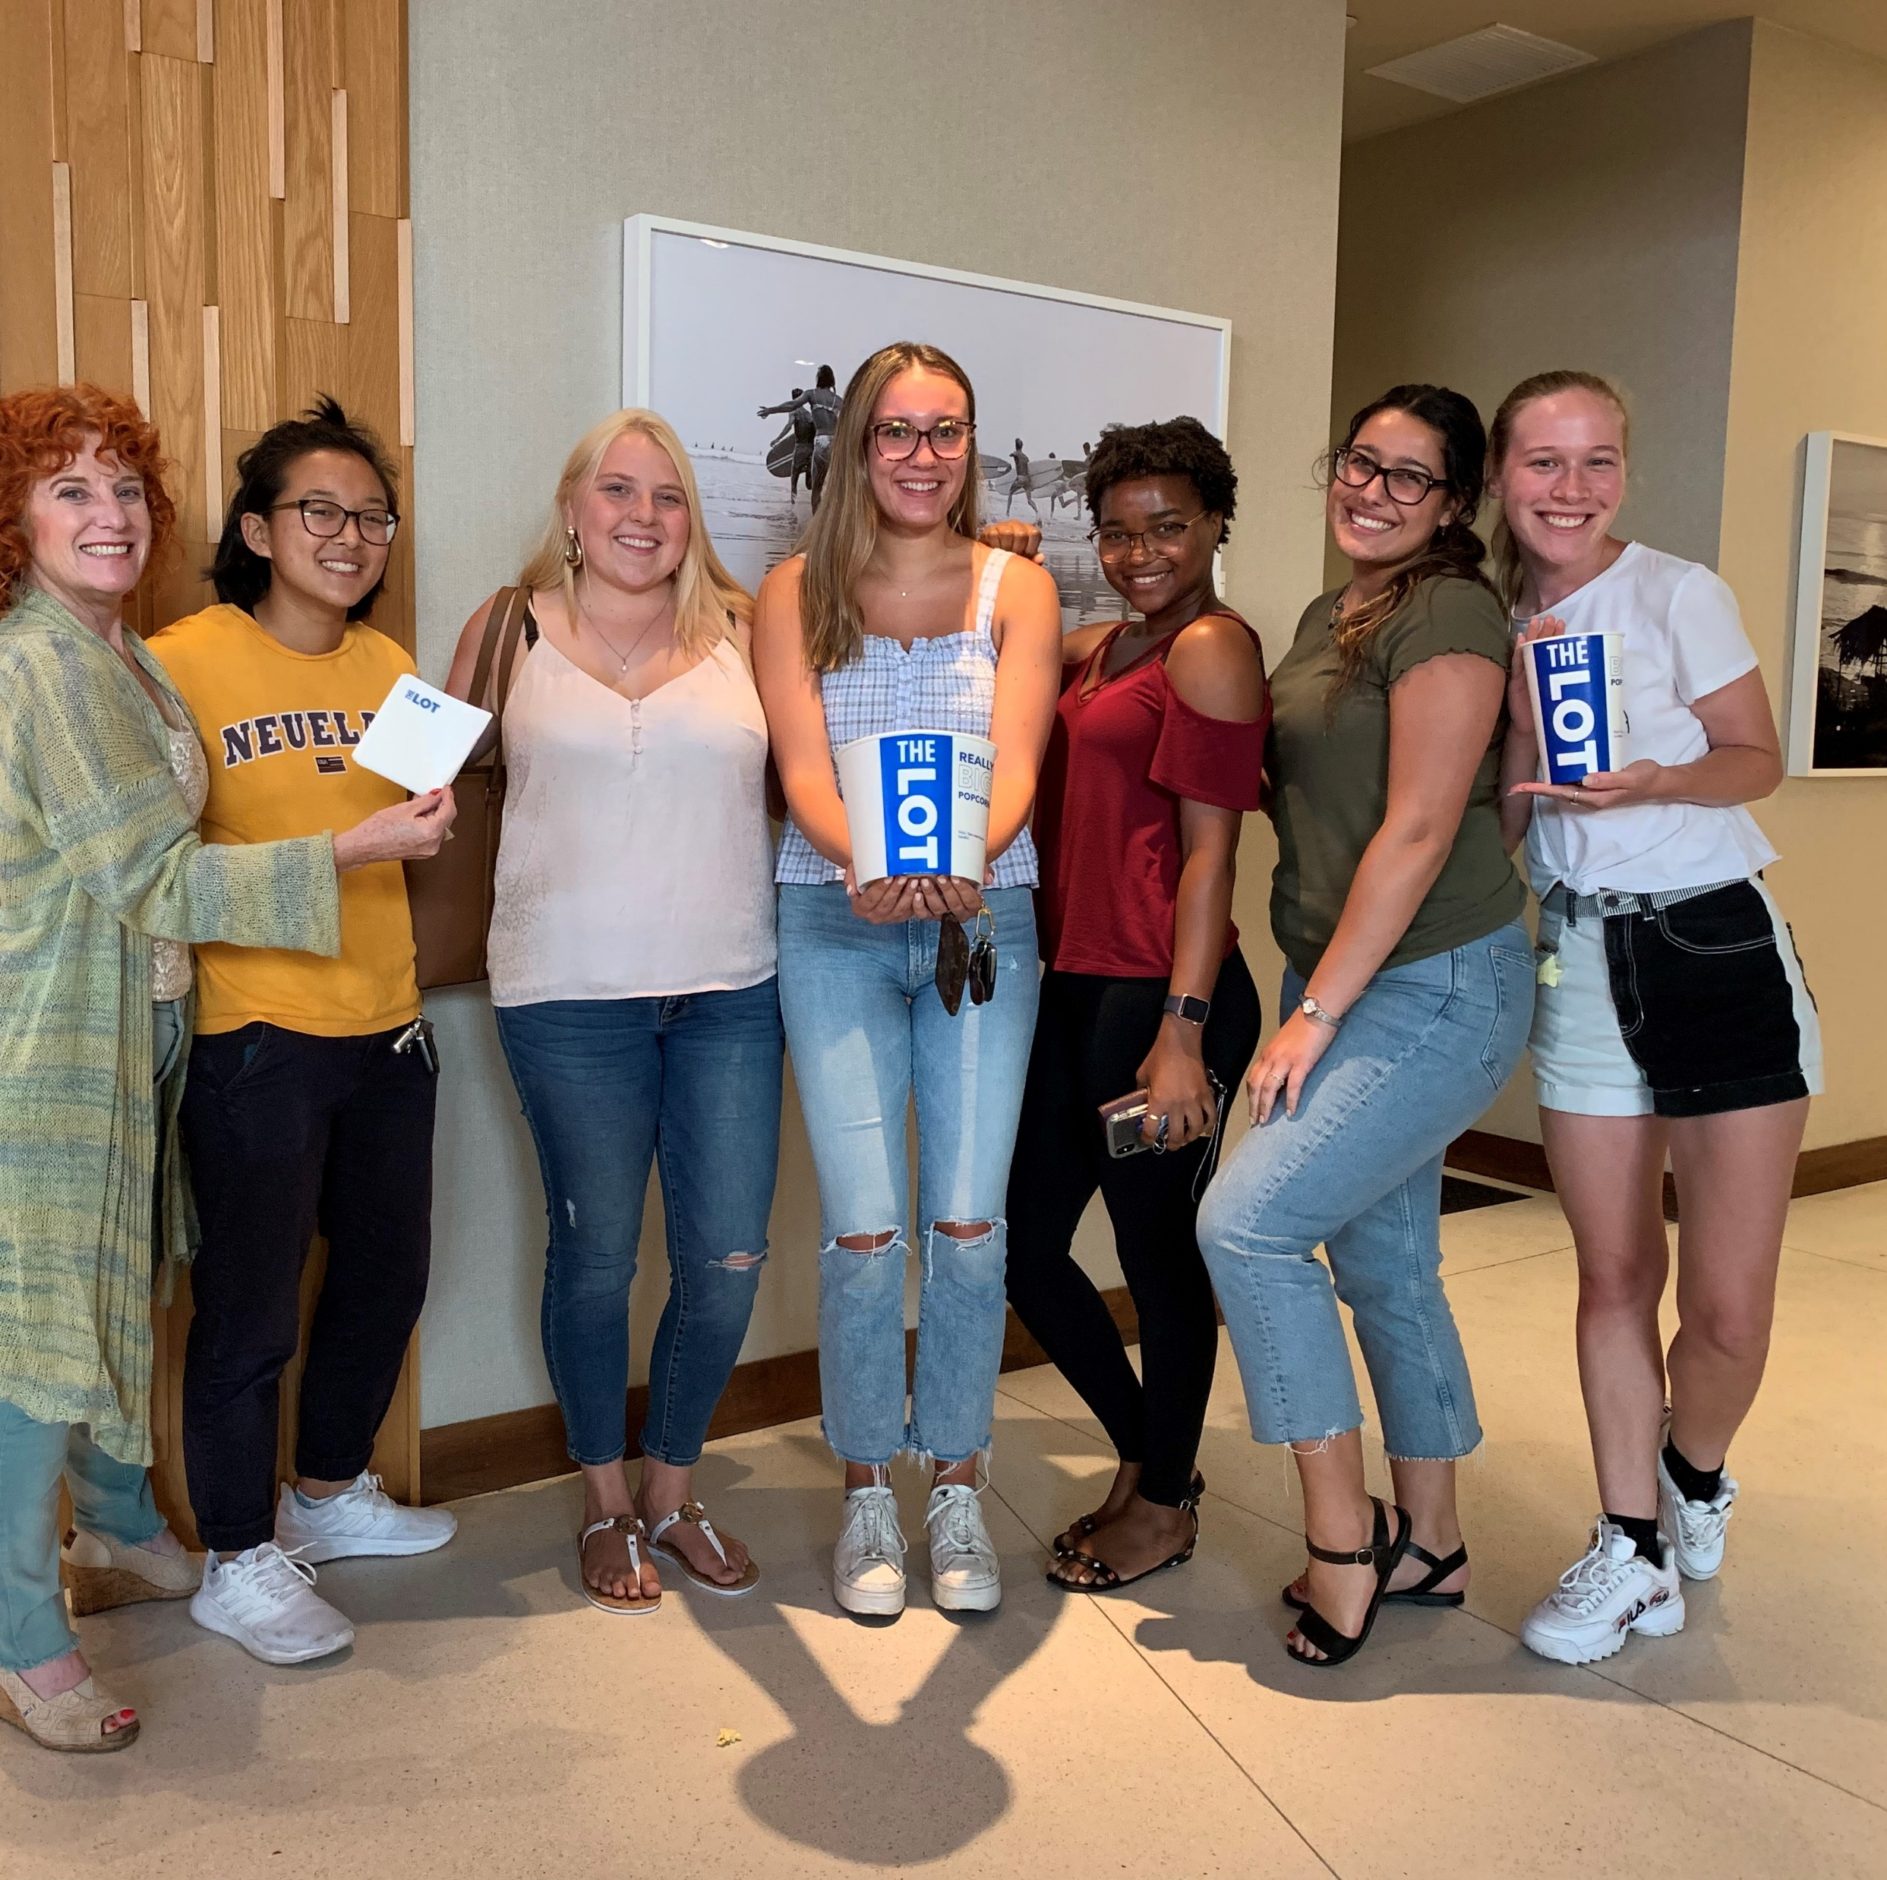
Organizational Excellence
Add Diversity Statement to Mission Statement
Recruit diverse board members
Continue to recruit diverse interns

Slide 5
Promotions and Events
Collateral should include more diverse faces of color, visible diversities.
Events (Enjoya La Jolla et al) can add components to attract diverse artists, musicians and pop ups
Reach out to allies regarding current issues
Bring website to ADA compliance

Slide 6
Merchant Education /Resources + Economic Development
Host diversity training and marketing course
Co-host an event with Chambers of Commerce representing diverse members (Central San Diego Black Chamber of Commerce; Asian Business Association, San Diego County Hispanic Chamber of Commerce; San Diego Equality Business Association/LGBTQ; et al)*
Reach out student groups representing diversity to recruit staff/interns/customers
Work with brokers to attract more diverse businesses. Identify grants that might help with this effort
Educate merchants about the Get it Done app
Block captains. Get to know and celebrate diverse business community
Source: sdchamber.org/about/chamber-partners/

Slide 7
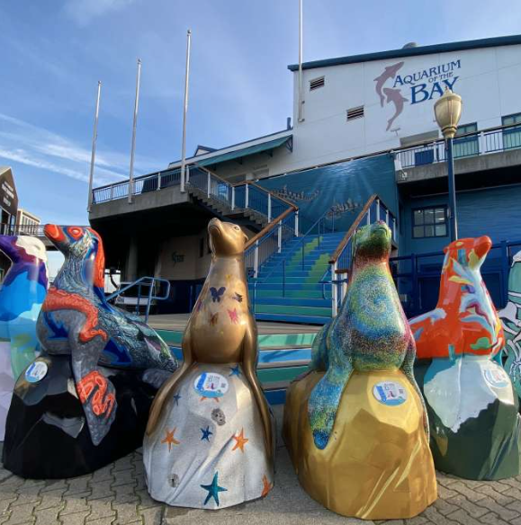
Design
Make sure we are including diverse artists and organizations in the "Seal Project" as we create our plans
Reach out to city to discuss the complexity of the public art process
Insure Holiday Décor is inclusive

Slide 8
Next Steps
Capture/Edit notes from today
Bring Recommendations to Marketing Committee Next Week (June 23, 4:00 via Zoom)
Have BOD Adopt Resolution Diversity Statement and Initiatives (Meeting Date: July 8, 2020; 4:00 PM)
Modify Strategic Plan for Ratification (Meeting Date: August 12, 2020)
Send Press Release

